Slide 1
Digital Portfolio
STUDENT NAME:- SAHIL JAIN. J
REGISTER NO :- 212402418
NMID:- asunm1301212402418
DEPARTMENT:- BCA
COLLEGE:- AGURCHAND MANMULL JAIN COLLEGE,
MADRAS UNIVERSITY

Slide 2
INTERACTIVE PORTFOLIO USING FRONT-END DEVELOPMENT

Slide 3

AGENDA
Problem Statement
Project Overview
End Users
Tools and Technologies
Portfolio design and Layout
Features and Functionality
Results and Screenshots
Conclusion
Github Link

Slide 4

PROBLEM STATEMENT
In today’s competitive digital world, showcasing skills, projects, and achievements through a professional online presence is essential.
Traditional resumes often fail to highlight creativity, interactivity, and practical skills. Without a personal portfolio website, it becomes difficult for developers and designers to:
Effectively demonstrate their skills and projects in an engaging way.
Build a strong personal brand and professional visibility
Provide recruiters, clients, and peers with easy access to their work and contact details.
This project aims to solve the problem by creating a responsive, user-friendly, and interactive personal portfolio website that highlights technical skills, showcases projects, and makes networking seamless.

Slide 5

PROJECT OVERVIEW
This project is a personal portfolio website designed to showcase my skills, projects, and achievements in a professional and engaging manner.
It is built using HTML, CSS, and JavaScript with a fully responsive layout to ensure seamless access across devices.
The website includes:
Hero Section – Introduction with profile image.
About Section – Brief summary of background and goals.
Skills Section – Display of technical skills with icons.
Projects Section – Interactive project cards with preview modal.
Contact Section – Contact form and social media links.
Additional Features – Sticky navbar, mobile-friendly menu, back-to-top button, and smooth animations.
This portfolio serves as a digital identity, helping me connect with recruiters, peers, and clients while reflecting both creativity and technical expertise.

Slide 6
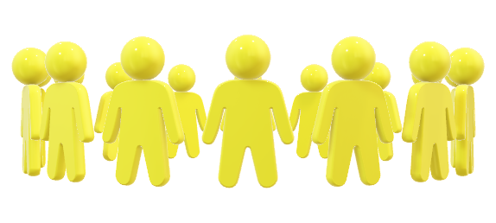
WHO ARE THE END USERS?
Students → to showcase academic projects, skills, and learning journey.
Freelancers → to attract clients by displaying completed work and services offered.
Job Seekers → to present skills, projects, and achievements to recruiters and employers.
Professionals → to build a strong digital presence, expand networks, and highlight career growth.

Slide 7
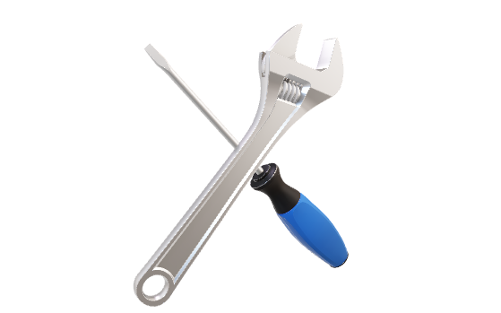
TOOLS AND TECHNNIQUES
Tools Used:-
HTML → for webpage structure
CSS → for styling and layout
JavaScript → for adding interactivity
VS Code → for writing code
GitHub → for hosting & sharing
Techniques Used:-
Responsive Design → adjusts for mobile & desktop
Grid & Flexbox → clean and organized layouts
Event Handling → buttons, menus, image pop-ups
Transitions & Effects → smooth animations
Form Design → simple contact form for users

Slide 8

PORTFOLIO DESING AND LAYOUT
Sections included:
Hero Section → Introduction & profile picture
Home / About Me → Short bio and career goals
Skills → Technical skills with icons
Projects → Showcase of work with previews
Contact → Contact form & social links
Footer → Copyright & credits
Responsive Layout (Mobile + Desktop View)

Slide 9

FEATURES AND FUNCTIONALITIES
Navigation bar with smooth scrolling
Project showcase with images/details
Interactive elements (hover effects, animations)
Contact form with validation
Responsive design for all devices

Slide 10
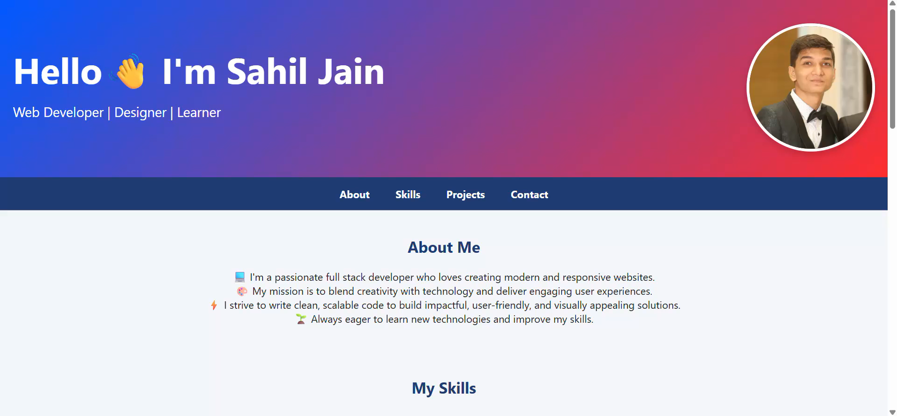
RESULTS AND SCREENSHOTS

Slide 11
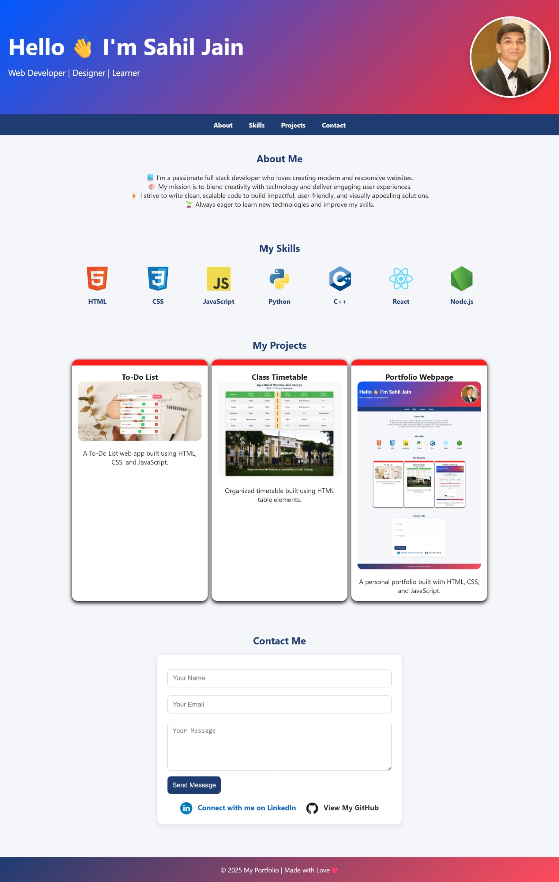
RESULTS AND SCREENSHOTS

Slide 12
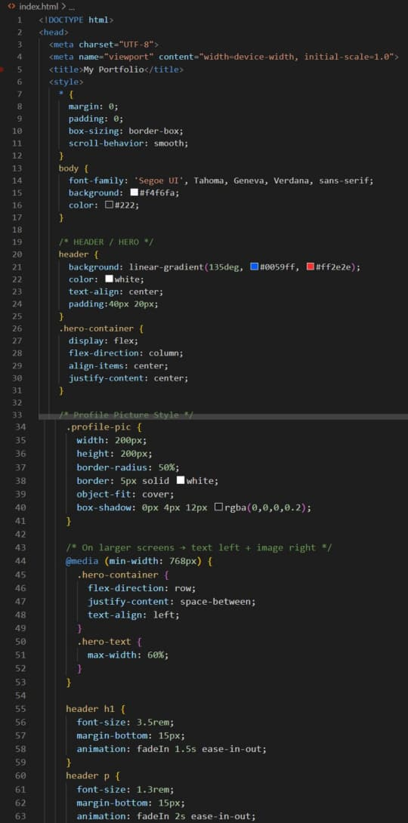
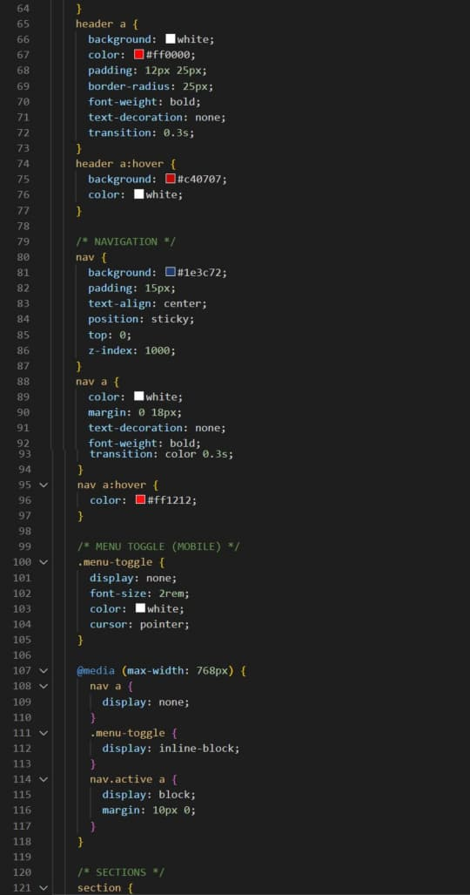
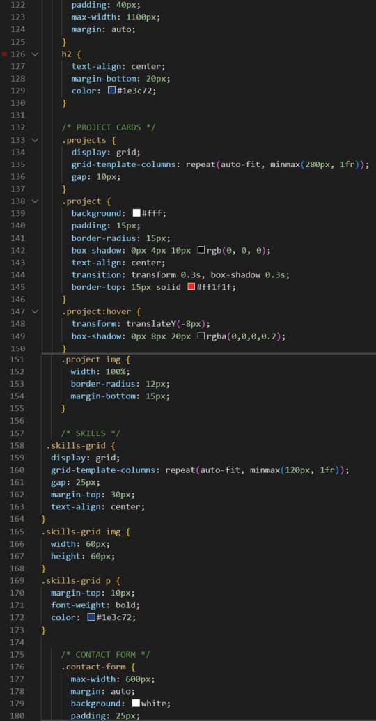
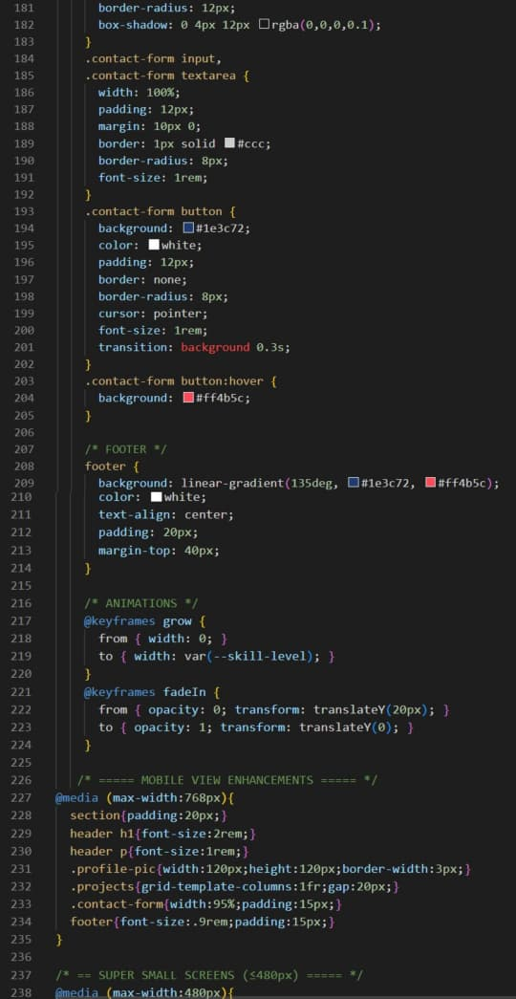
PROGRAM CODE

Slide 13
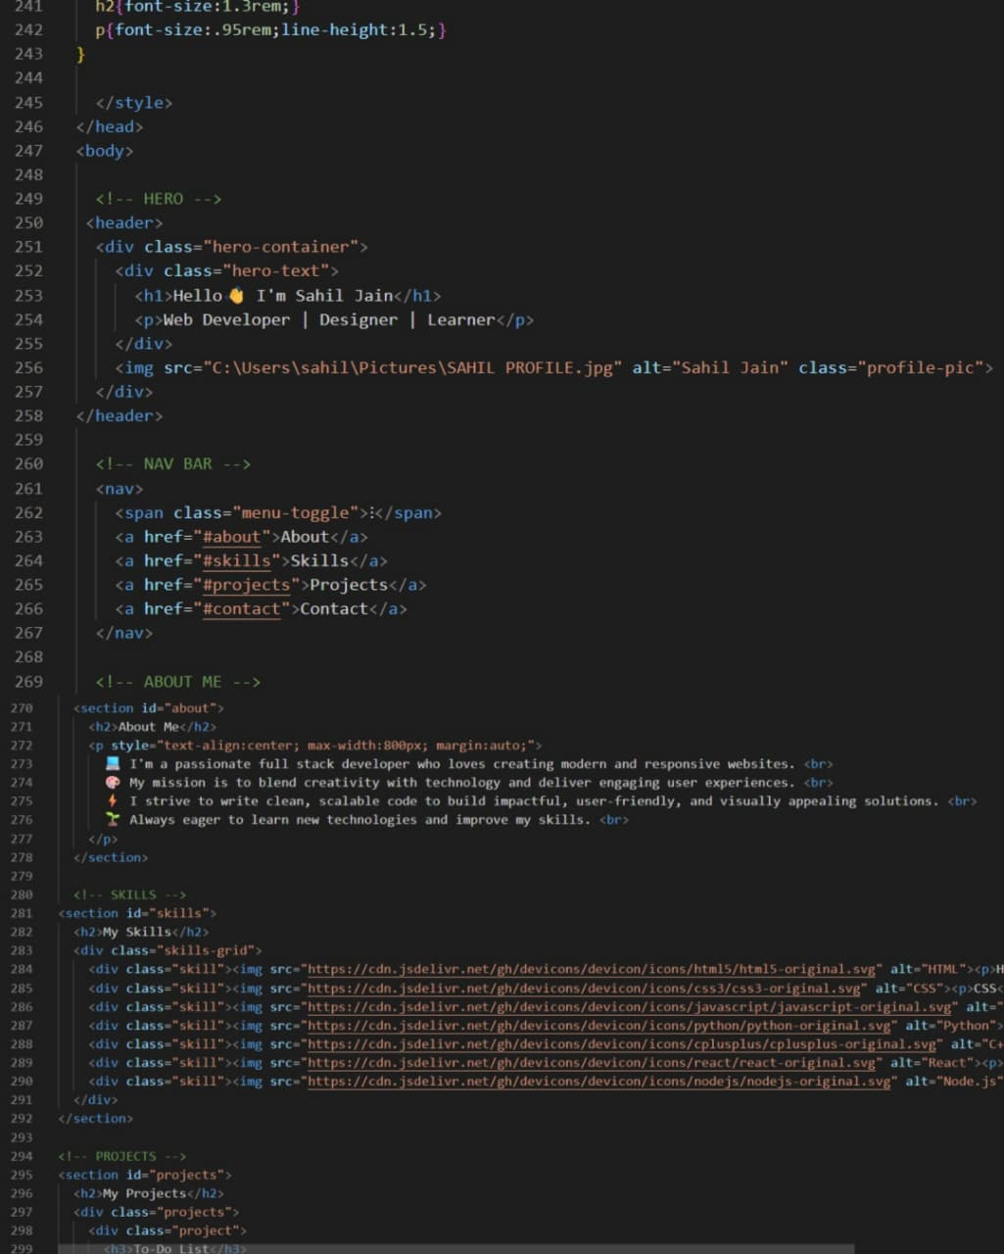
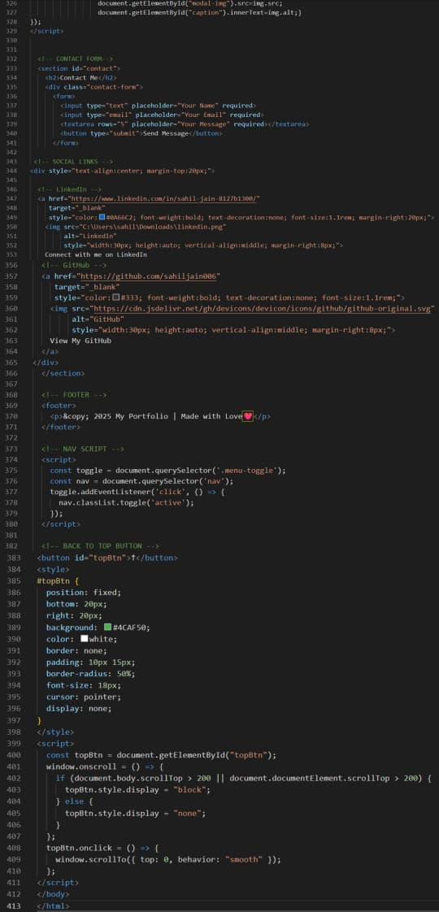
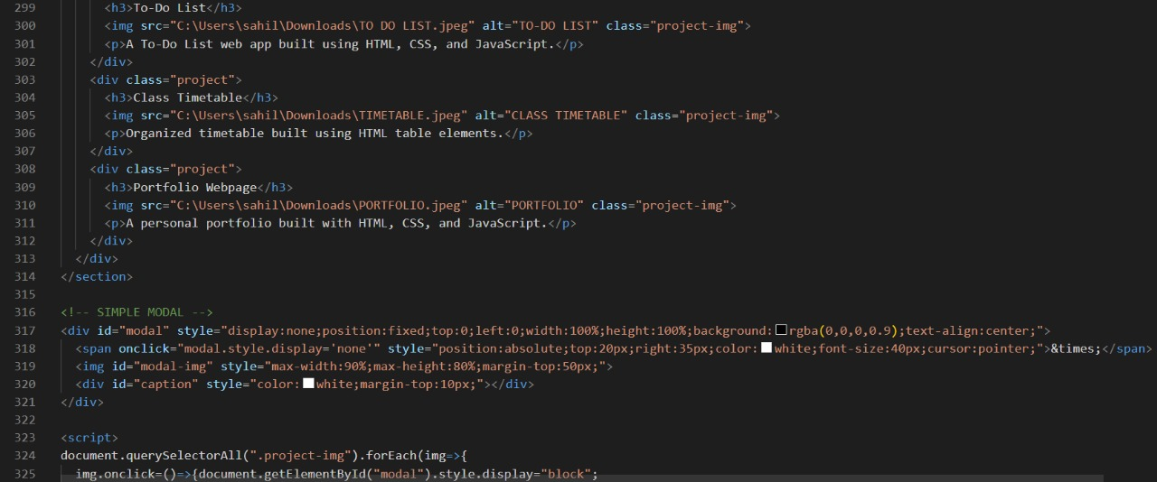
PROGRAM CODE

Slide 14

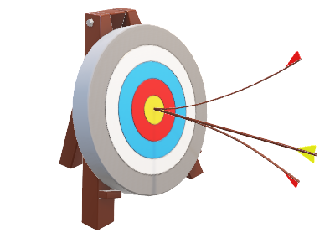
CONCLUSION
Simple and user-friendly portfolio
Responsive design for all devices
Professional way to showcase skills
Inspires others to build their own websites
Encourages digital presence in today’s world
Benefit to Society:- Promotes digital literacy and inspires individuals to build their own online identity
“A step towards digital empowerment.”

Slide 15

GITHUB REPOSITORY LINK
https://github.com/sahiljain006/TNSDC-FWD-DigitalPortfolio.git

Slide 16


